Slide 1
Продающий заголовок вашего
«маркетинг-кита»
захватывающее предложение по организации игры «Мафия» для event-агентств
наши клиенты:
тел.:
e-mail:
сайт:
(495) 226-74-30
art@prcomm.ru
www.kit5.ru

Slide 2
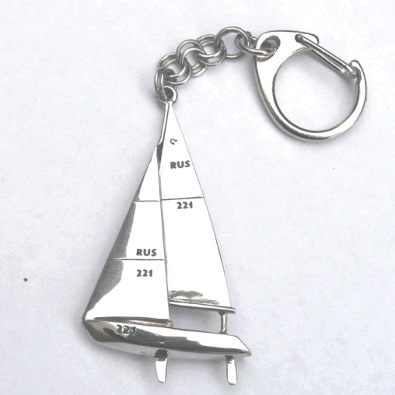
Виды товара
основной тезис ваших товаров (его прочтут)
Броши
Фляжки
Сумки
Клатчи
Галстуки
Обложки
Очки
Брелки
Перчатки

Slide 3
Смелый корпоратив
the planets, stars, galaxies
The universe is commonly
although this usage may differ
Описание проводимого мероприятия или ситуации или проданного товара. The universe is commonly defined as the totality of everything that exists including all physical matter and energy, the planets, stars, galaxies, and the contents of intergalactic space, although this usage may differ with the context
Отзыв заказчика
даже не мог представить, насколько это может быть интересно
The universe is commonly defined as the totality of everything that exists including all physical matter and energy, the planets, stars, galaxies, and the
Сергей Жуков, владелец банка
тел.:
e-mail:
сайт:
(495) 226-74-30
art@prcomm.ru
www.kit5.ru

Slide 4
Почему мы лучшие?
основной тезис ваших тарифов или вариантов (его прочтут)
Мы предлагаем Вам лучший товар
The universe is commonly defined as the totality of everything that exists including all physical matter and energy,
У нас лучшие цены на рынке
The universe is commonly defined as the totality of everything that exists including all physical matter and energy,
индивидуальная программа на выезд
The universe is commonly defined as the totality of everything that exists including all physical matter and energy,
экономия вашего времени
The universe is commonly defined as the totality of everything that exists including all physical matter and energy,
индивидуальная программа на выезд
The universe is commonly defined as the totality of everything that exists including all physical matter and energy,
У нас лучшие цены на рынке
The universe is commonly defined as the totality of everything that exists including all physical matter and energy,
тел.:
e-mail:
сайт:
(495) 226-74-30
art@prcomm.ru
www.kit5.ru

Slide 5
Варианты и тарифы
основной тезис ваших тарифов или вариантов (его прочтут)
Вечеринка в офисе
Вечеринка в загородном доме
Вечеринка в офисе
Описание проводимого мероприятия или ситуации или проданного товара. The universe is commonly defined as the totality of everything that exists including all physical matter and energy, the
Описание проводимого мероприятия или ситуации или проданного товара. The universe is commonly defined as the totality of everything that exists including all physical matter and energy, the
Описание проводимого мероприятия или ситуации или проданного товара. The universe is commonly defined as the totality of everything that exists including all physical matter and energy, the
• The universe
• is commonly defined
• as the totality of everything
• that exists including all
• matter and energy
• The universe
• is commonly defined
• as the totality of everything
• that exists including all
• matter and energy
• The universe
• is commonly defined
• as the totality of everything
• that exists including all
• matter and energy
Стоимость:
от 74 000 руб.
Стоимость:
от 74 000 руб.
Стоимость:
от 74 000 руб.
тел.:
e-mail:
сайт:
(495) 226-74-30
art@prcomm.ru
www.kit5.ru

Slide 6
Продающий заголовок
as the totality of everything that exists including all physical matter and
The universe is commonly defined as
the totality of everything that exists including all physical matter and energy, the planets, stars, galaxies, and the contents of intergalactic space, although this usage may differ with the context The universe is commonly defined as the totality of everything that exists including
The universe is commonly defined as the totality of everything that exists including all physical matter and energy, the planets, stars, galaxies, and The universe is commonly defined as the totality of everything that exists including all physical matter and energy, the planets, stars, galaxies, and
тел.:
e-mail:
сайт:
(495) 226-74-30
art@prcomm.ru
www.kit5.ru

Slide 7
Сделать первый шаг — очень просто!
The universe is commonly defined as the totality of everything that exists including all physical matter and energy
(495) 226-74-30
art@prcomm.ru
www.kit5.ru

